Slide 1
VISTA Meta Data Project
September IPR Slides

Slide 2
35 Years of VISTA IP - Reframed
CPRS/
JLV/ …
New
Clients
what’s
changing
and who
did it
3500+ Opaque and Brittle
Transparent
Emulator
What’s in here?
CRU(R)D
Reframe
MVDM
Clear separation
in Javascript
What’s Changing/Who did it?
Anything goes
MUMPS
VDM
FileMan
FileMan
Notes:
VMDP: 35 Years of Successful VISTA IP - reframing in modern terms, language
Left: NEARLY ALL KNOW THIS … (from top down) 3500, opaque, brittle - no sync event model - what’s in here? (no docs/ no test suite/ apis - keystones of programming?) - anything goes
Right: (VDP in green) clear layering, internal and external apis doced and tested, 2 APIs: backward compatible AND new CRURD API, sync event model.
… both the SAME BEHAVIOR, do the same thing! The project is not about new behavior - it’s about existing behavior in maintainable, modern form.
Why existing clients - keeps you honest AND to be practical
Problem is how to PRACTICALLY GO FROM NOW TO THEN, is it practical?

Slide 3
How? - Multiple Dimensions
#’s Driven: 3500 RPCs/ 1050 CPRS, 2641 files, …
O
P
E
N
G
I
T
S
RPC
Emulation
RPC
Sessions
API
Signatures
8994
Master
VDM
Database
Diffs
RPC
Sessions
Clone
Analytics
VISTA
Data Model
DD
DD+
DD✔️
VPR
Problems
Allergies
Med Orders
Vitals
…
Notes:
… we’re not MUMPS code examiners … won’t scale
Numbers-driven, Scoped (which is NOT typical)
VDM: base model is generated
MVDM: behaviors from three sources building on a normalized base model
RPC Emulate: sessions again and 8994/function signatures
Domain by domain, vertical not horizontal
… in the OPEN, we’re transparent, anyone can take at any time, no big bang …
Key end “deliverable” is clear scoping #’s - done and to do (research part)

Slide 4
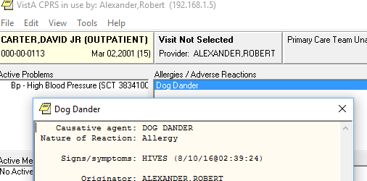
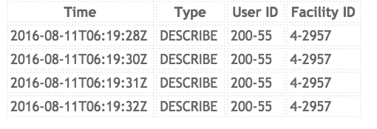

Let’s See It! (#23)
CPRS “fooled”
Browser Event Viewer
Change/
Audit Events
Ye Olde
MUMPS
Emulator
MVDM
Notes:
“Let me see it!” … Organizing principle
Basic in place: “fool” CPRS, events show in a browser
Vertical - going domain by domain, emulation on and off
First pass cosmetically - far from final form
New Client Demo will come too

Slide 5
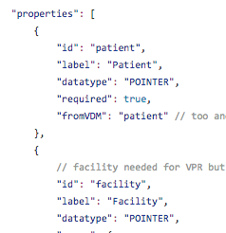
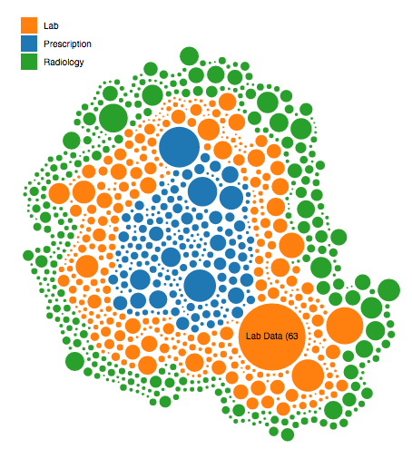
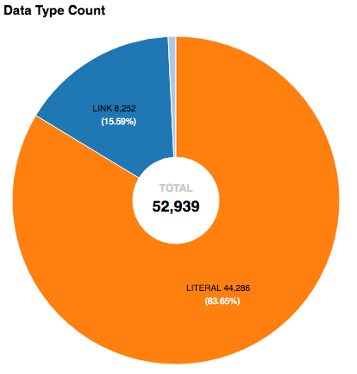
Document “What’s going on?”
Notes:
all the formalisms and models enable
we have let’s us “document” VISTA broadly - graphically and in browsable documents

Slide 6
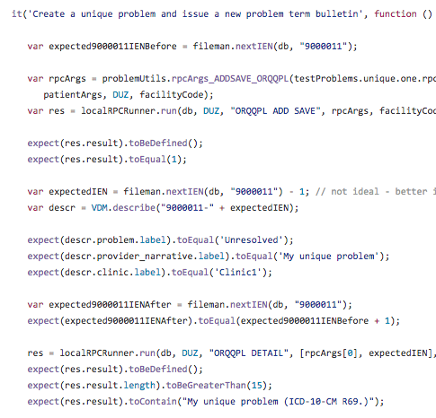
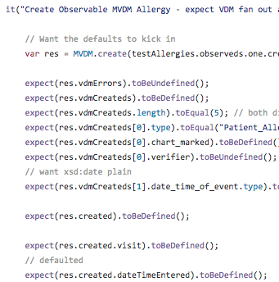
Regression Test “What’s going on?”
Notes:
capturing behavior - formally and strictly test behavior

Slide 7
Model for all Choices
Choices:
Evolve VISTA
Partially Replace VISTA
Wholly Replace VISTA
In every case, need to “Know VISTA”
Proven, Documented Master VISTA Data Model
Notes:
Knowing VISTA == documented, proven model

Slide 8
State of Project

Slide 9
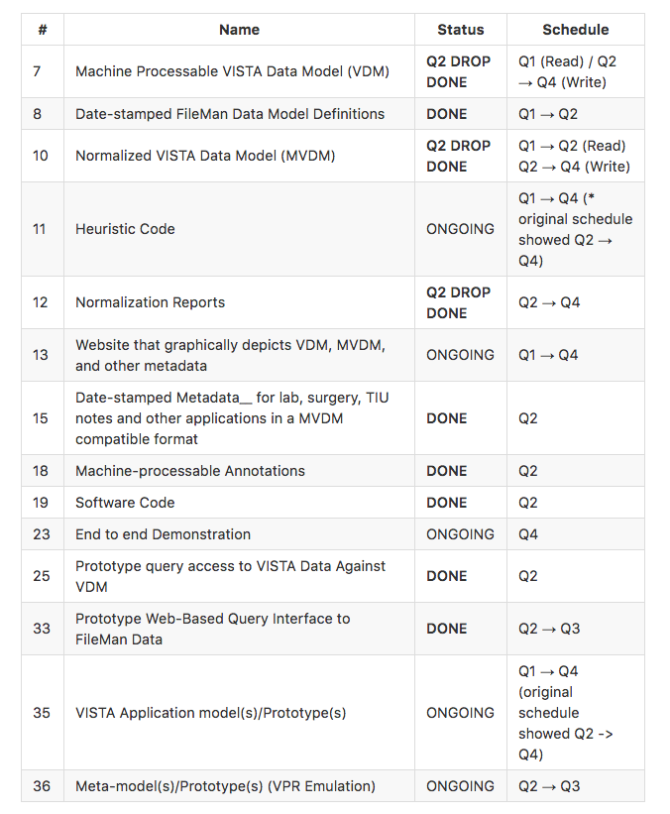
Results to Date

Slide 10
Technical Work Remaining
“Always Ready” Vertical Demo Evolve and Enhance:
Expand Clients (JLV, Web, Event Synchronization)
Core domains completed (vitals/allergies/problems)
Packaging/ ease of use from our open Github
Event Form for Audit and Synchronization
Infrastructure and Architecture (“Under the Hood”)
MVDM identity (vs VDM/local) - enterprise identifiers - va:{location}:localId AND “portable K”
Layer Separation - MVDM self-contained (no VDM references) with only Javascript behaviors
VDM Generated: distinct DD, DD+, DDC
Improved Data/Interfacing Analytics: Clone analysis, RPC sessions
Locking Scope - patient, domain …
Two more Domains - Medication (Orders) and Patient
Security Module and its part in the demonstration
Presentation/Documentation including Graphics, much of it generated, enabling use and scoping
16 weeks from August 29th through December 16th.

